Slide 1
STD – X, CHAPTER – 4, CHEMISTRY
CHEMICAL REACTIONS AND EQUATIONS
1.2 COMBINATION REACTION
By Hembrom sir (21/04/2021)

Slide 3
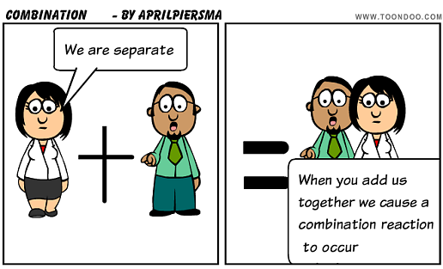
1. COMBINATION REACTION

Slide 10
HOME WORK FOR TODAY
What are the different types of chemical reactions?
What do you mean by combination reactions? Give examples.
What do you mean by exothermic reactions? Give examples.
Why respiration is considered as exothermic reaction? Give equation for the same.

