Slide 1
STD – X, CHAPTER – 1, CHEMISTRY
CHEMICAL REACTIONS AND EQUATIONS
1.6 REDOX REACTIONS
By Hembrom sir (30/04/2021)

Slide 2
REVISION SLIDE

Slide 3
REDOX REACTIONS
OR
OXIDATION REDUCTION REACTIONS

Slide 4
OXIDATION – IT MEANS 1. ADDITION OF OXYGEN
or
2. REMOVAL OF HYDROGEN

Slide 5
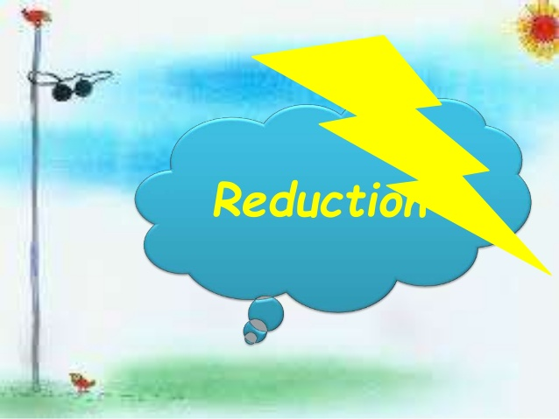
REDUCTION – IT MEANS 1. ADDITION OF HYDROGEN
or
2. REMOVAL OF OXYGEN

Slide 6
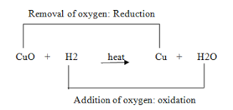
WHAT IS REDOX REACTION ?
REDOX – REDUCTION + OXIDATION.
BOTH PROCESSES (OXIATION AND REDUCTION )OCCUR SIMULTANEOUSLY.
- HENCE, ONE SPECIES IS OXIDISED, ANOTHER IS REDUCED.

Slide 10
HOME WORK FOR TODAY
What do you mean by oxidation reactions ? Give two examples.
What do you mean by reduction reactions ? Give two examples.
What do you mean by redox reactions ? Give three examples indicating (by arrow mark) the process of oxidation and reduction.
What do you mean by oxidizing agent? Give an example. (find out from Srijan book)
What do you mean by reducing agent? Give an example. (Find out from Srijan book)

