Slide 1
STD – X, CHEMISTRY
ACIDS,BASES AND SALTS
2.4 Reaction of metallic Oxides with Acids
and
Reaction of a non-metallic Oxide with Bases
By Hembrom sir (30/07/2021)

Slide 3
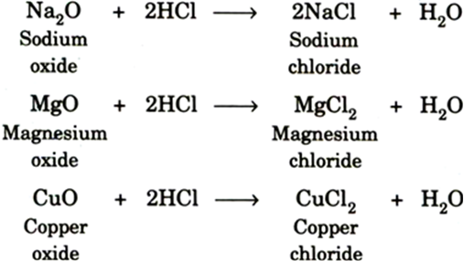

Slide 7
HOME WORK FOR TODAY
How do metallic oxides react with acids? Give three examples.
How do non-metallic oxides react with base? Give two examples.

