Slide 1
STD – XTH,
ACIDS,BASES AND SALTS
2.7 SALTS AND COMMON SALT
By Hembrom sir (16/08/2021)

Slide 6
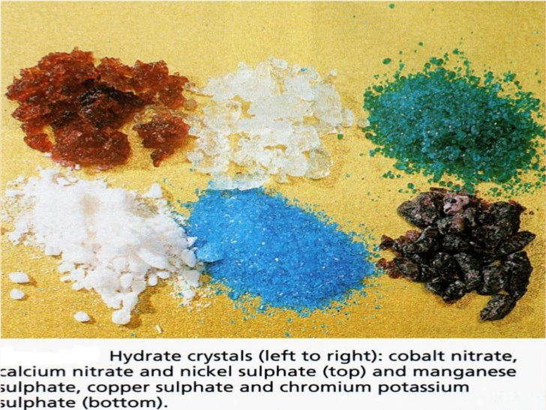

Slide 10
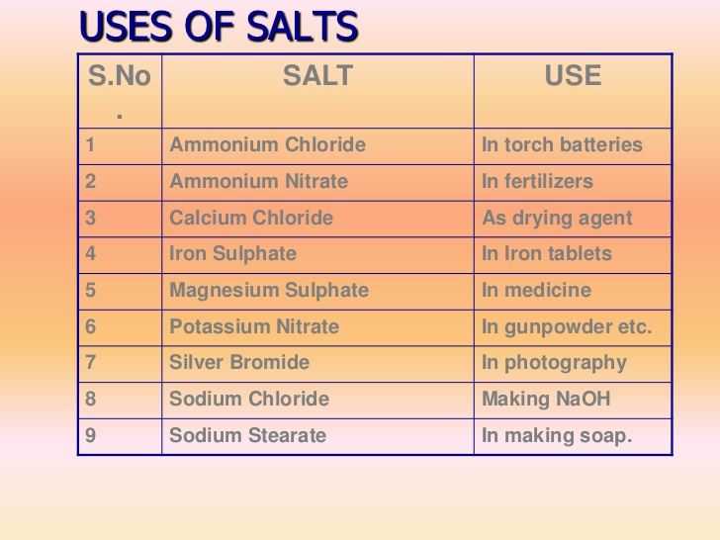

Slide 11
HOME WORK FOR TODAY
How is salt formed? Give examples.
How is the family of salts decided?
How is sodium chloride formed?
What is the formula of common salt?
What is rock salt?

